Slide 1
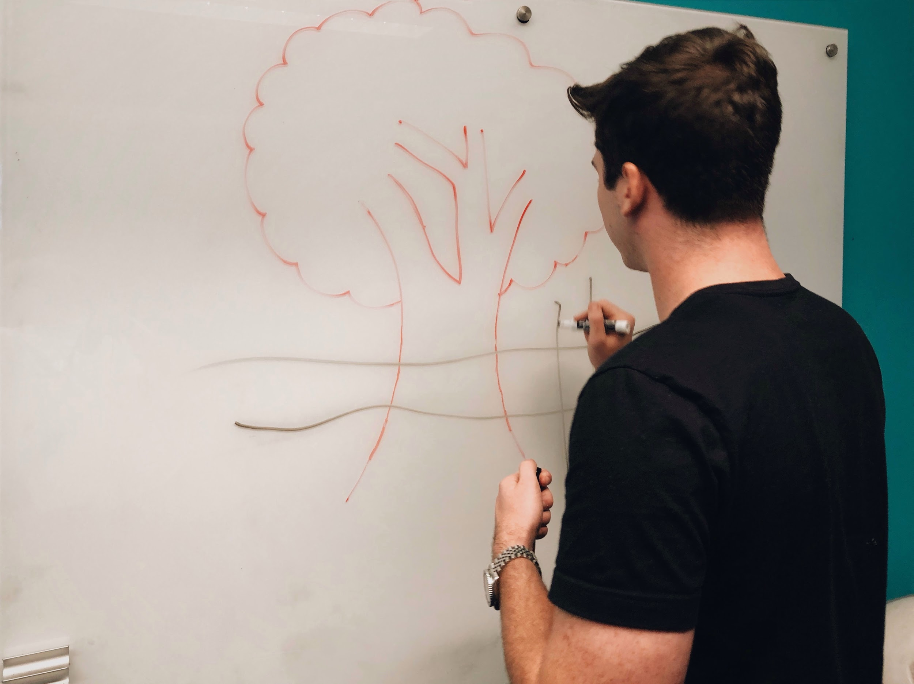
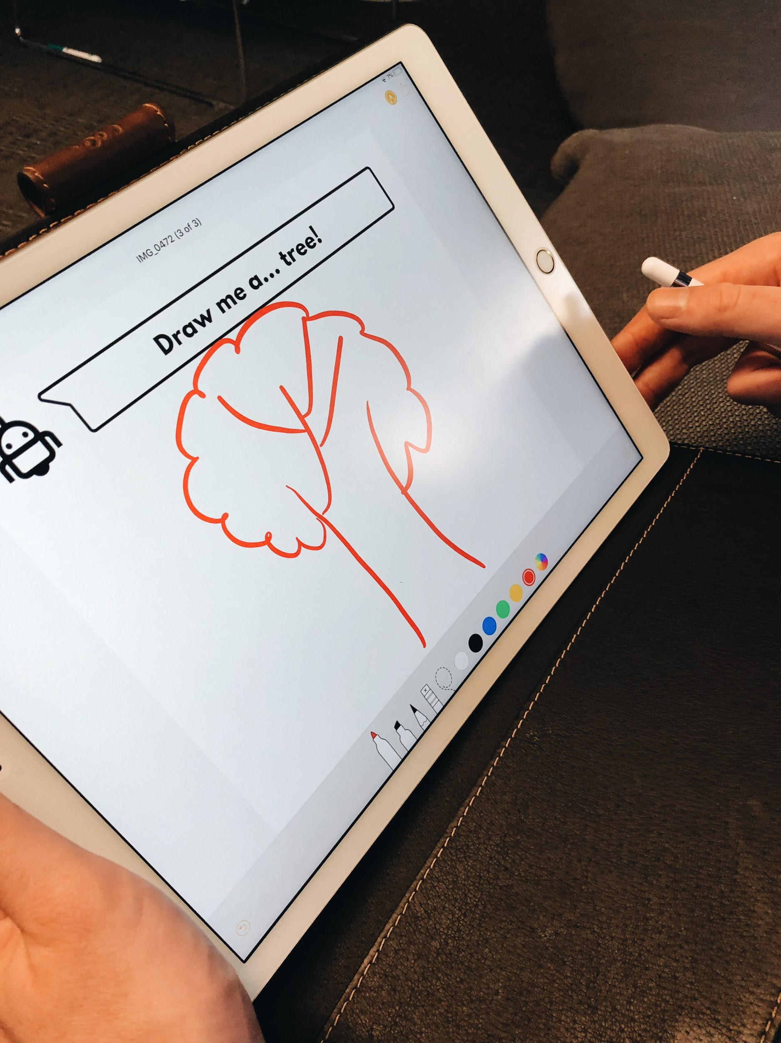
Artbot
Concept Video
–
Team Articulate

Slide 2
Artbot Antagonistic, artful companion
We set out to tackle the dreaded problem artists of all levels face during the creation process – the block.
The block is when artists become too attached to their work but are unable to see a path forward in their work that satisfies them.
Artbot attempts to free artists from this mode of thinking using a gameified approach coupled with long-term check-ins.

Slide 3
Artbot is designed to improve your creative wellness.

Slide 4
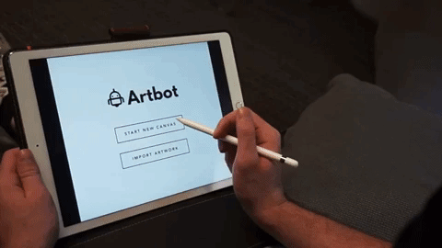
Three Tasks Simple
Upload or create a new canvas.

Slide 5
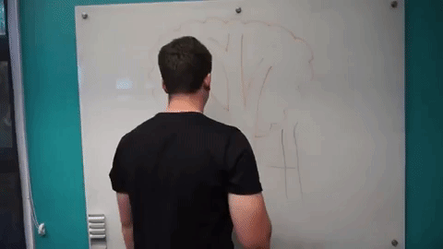
Three Tasks Medium
Create a disasterpiece.

Slide 6
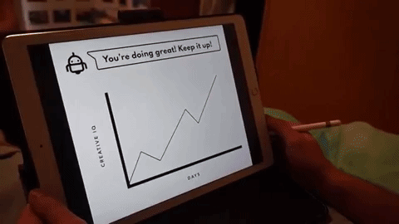
Three Tasks Complex
Check and monitor your CreativeIQ.

Slide 7
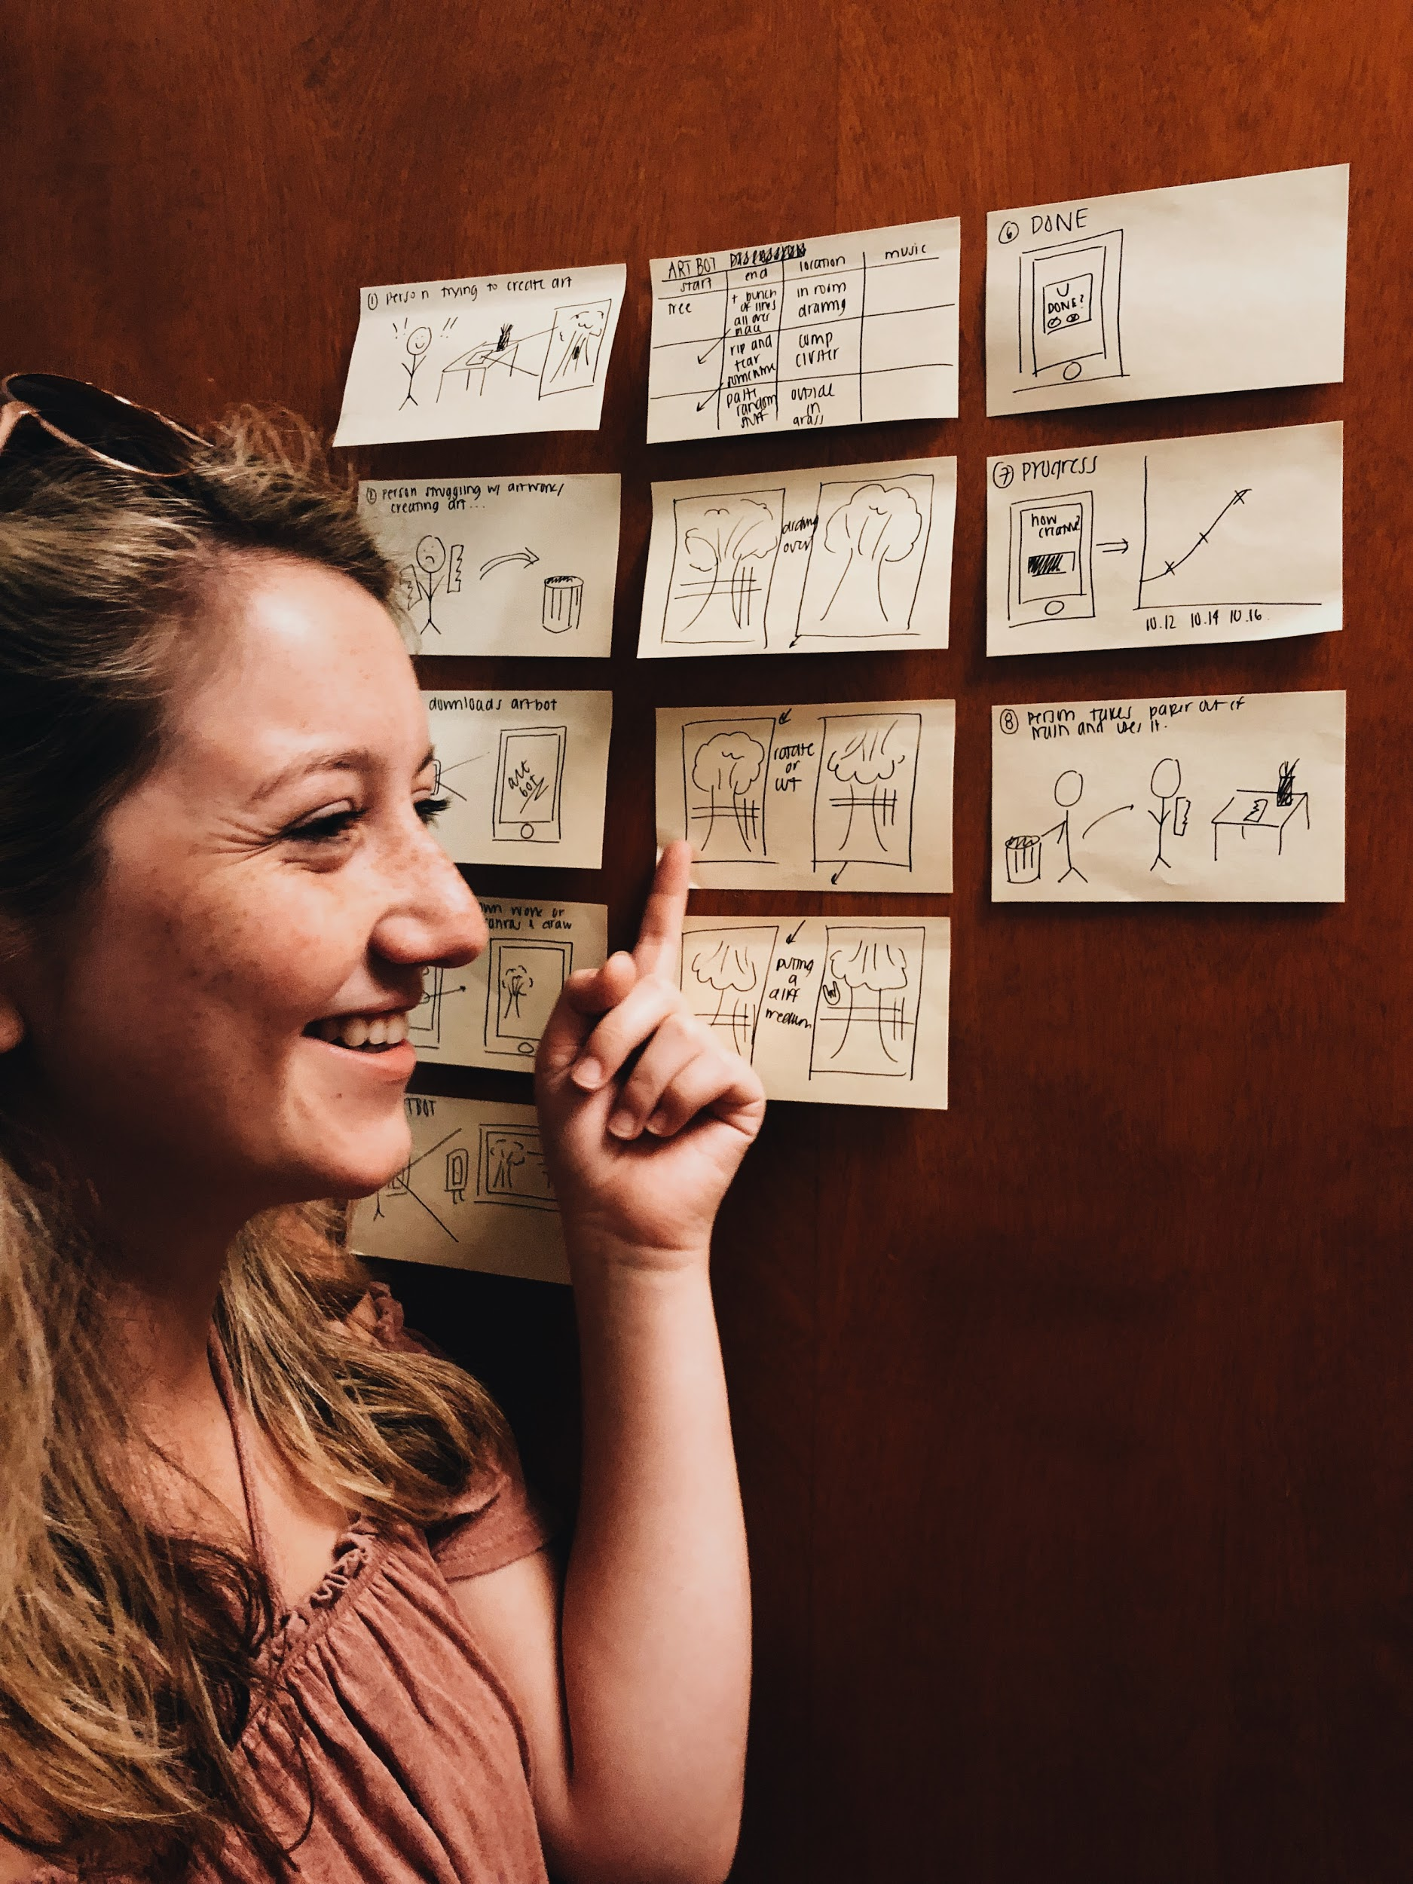
Video Storyboarding

Slide 8
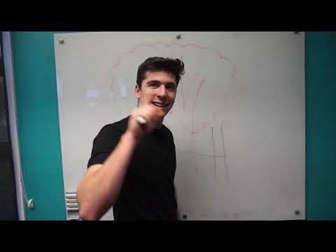
Concept Video

Slide 9
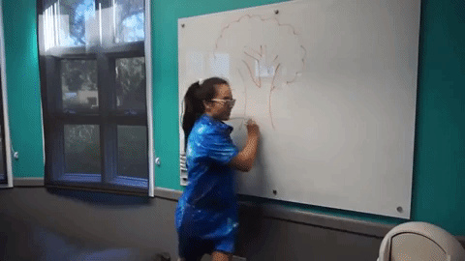
Thanks!
Love, Articulate

Slide 10
Video Storyboard in Detail - 001

Slide 11
Video Storyboard in Detail - 002

Slide 12
Video Storyboard in Detail - 003

